Slide 1
Sullivan County Coordinated Transportation Plan
Proposed Coordinated Transportation Plan

Slide 2
Overview
Study Process
Transportation Needs
Existing Services
Vision
Recommended Plan
Implementation Plan
Accelerated Implementation

Slide 3
Background
Initiated by Transportation Subcommittee of the Long Term Care Council
Address transportation needs of residents who fall through the cracks in terms of publicly available transportation services
Funded by Rural Business Opportunity Grant through U.S. Department of Agriculture

Slide 4
Project Goals and Objectives
Create a Coordinated Public Transit-Human Services Transportation Plan
Increase ability to access FTA funding
Maximize efficiency
Address broader workforce development, economic development, and environmental sustainability goals through improved transportation coordination and planning

Slide 5
Study Process
Existing
Conditions
Needs
Analysis
Service
Options
Proposed
Service Plan
Recommended
Actions

Slide 6
Transportation Needs
17,800 residents need transportation
Transit Cooperative Research Program
County demographics – 10% households have no car
Over 1,000,000 annual non-program trips needed
Greatest need is among people not eligible for various programs

Slide 7
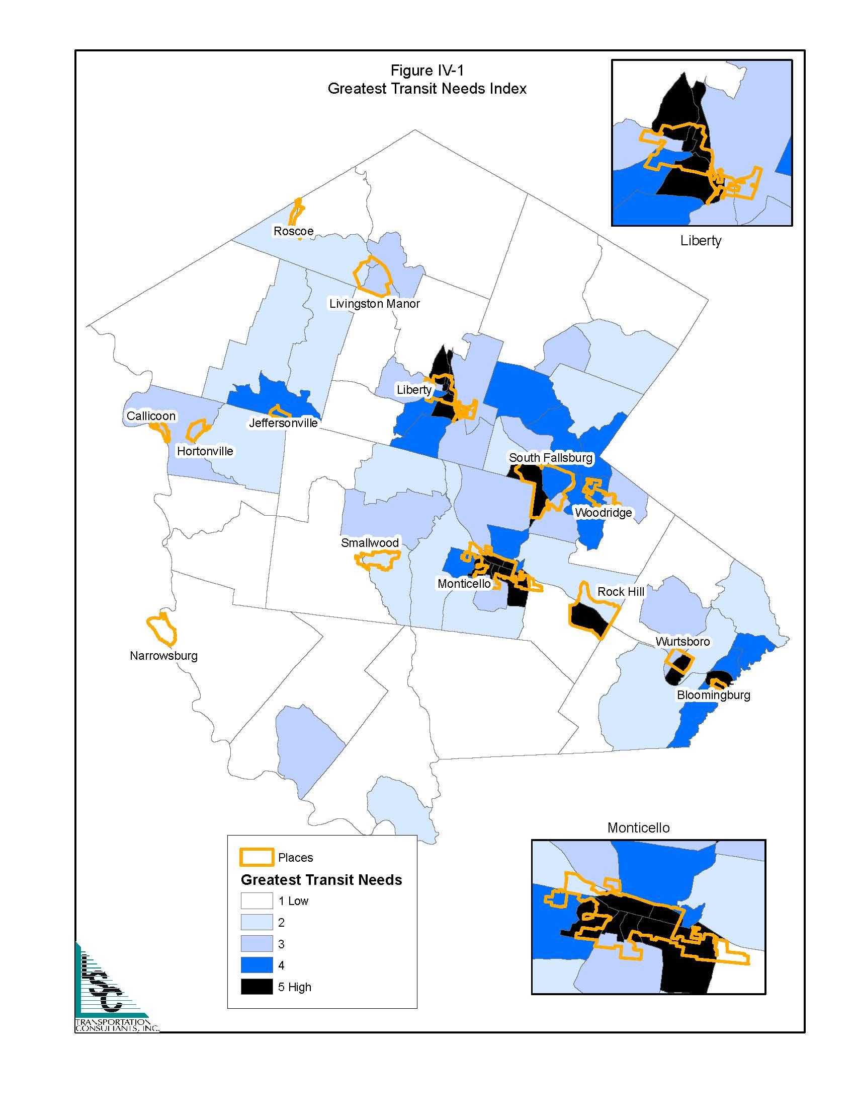

Slide 8
Transportation Programs
35 Transportation Providers
County
Non-profit Human Services Agencies
Private Bus Companies
Taxis
Medicaid Transportation
200 Vehicles
$6 Million spent annually (excluding Medicaid)
At least 16 funding sources

Slide 9
County Transportation Services
Sullivan County Transportation
Office for the Aging
Veterans Service Agency
Department of Family Services
Department of Community Services
Center for Workforce Development
Public Health Services
$2.1 million – 82.5% pass through funds

Slide 10
Peer Communities
Community | Population | Density | Cost per Passenger | Cost per Mile
Cherokee, NC | 13,000 | 65 | $24.02 | $2.83
Flathead County, MT | 90,300 | 18 | $9.52 | $3.28
Prairie Hills Transit, SD | 75,000 | 8 | $14.86 | $3.24
Sheridan, WY | 29,000 | 12 | $15.23 | $3.07
Oswego County, NY | 122,100 | 128 | $27.63 | $4.20
Sullivan County, NH | 43,700 | 81 | $14.74 | $2.63
Connecticut River Transit, VT | 58,100 | 23 | $12.72 | $1.56
Sullivan County, NY | 77,500 | 80 | $58.42 | $6.23

Slide 11
Vision for Transportation

Slide 12
Vision
A coordinated transportation system that meets transportation needs of residents and visitors to Sullivan County and provides access to employment, medical facilities, education, shopping, and recreation.

Slide 13
Strategies
Implement public transportation service.
Open the existing County services to the general public.
Add service earlier and later in the day to support employee work hours.
Increase the level of service to the Catskill Regional Medical Center.
Provide connections to Ulster and Orange Counties and intermodal facilities.

Slide 14
Strategies
Coordinate transportation services.
Consolidate services operated by County government.
Establish a County Transportation Coordinator.
Establish a Mobility Manager for Sullivan County.
Consolidate human services transportation with a single operator.

Slide 15
Strategies
Leverage available funding.
Increase efficiency of transit services.
Use available funds as local match for Federal Transit Administration funding.

Slide 16
Recommended Plan

Slide 17
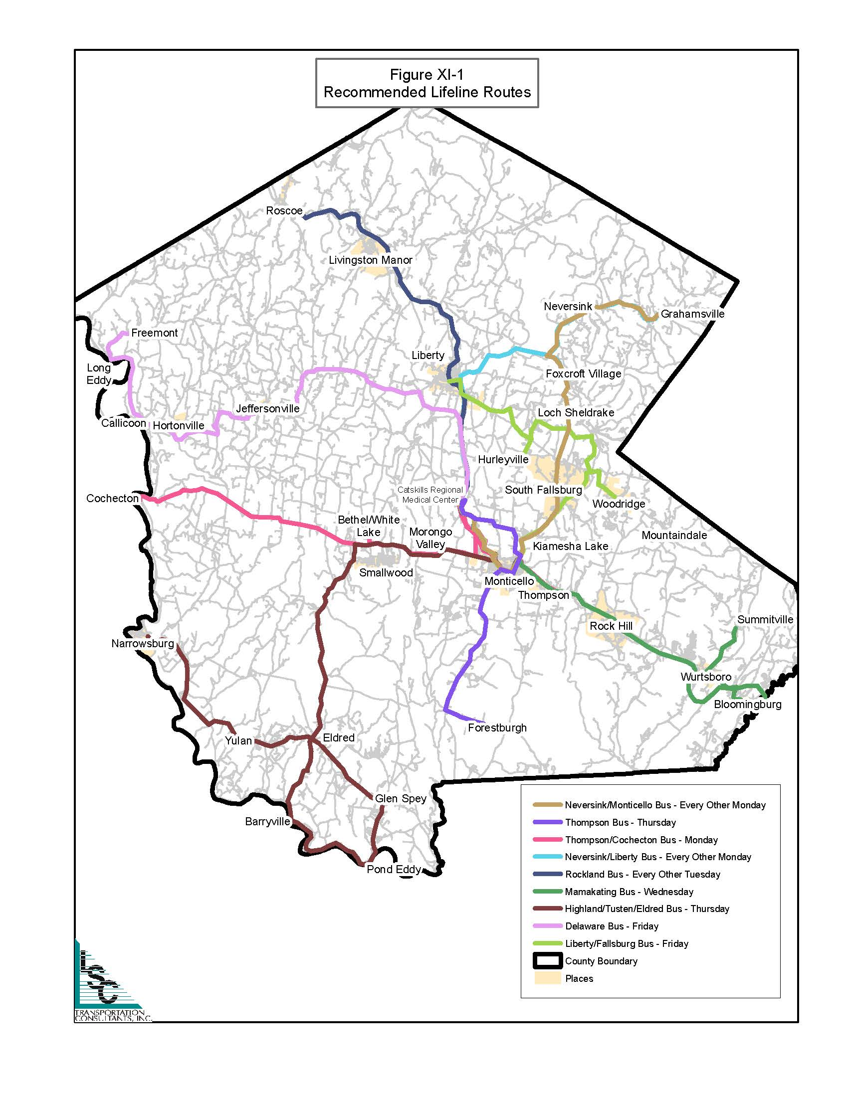

Slide 18
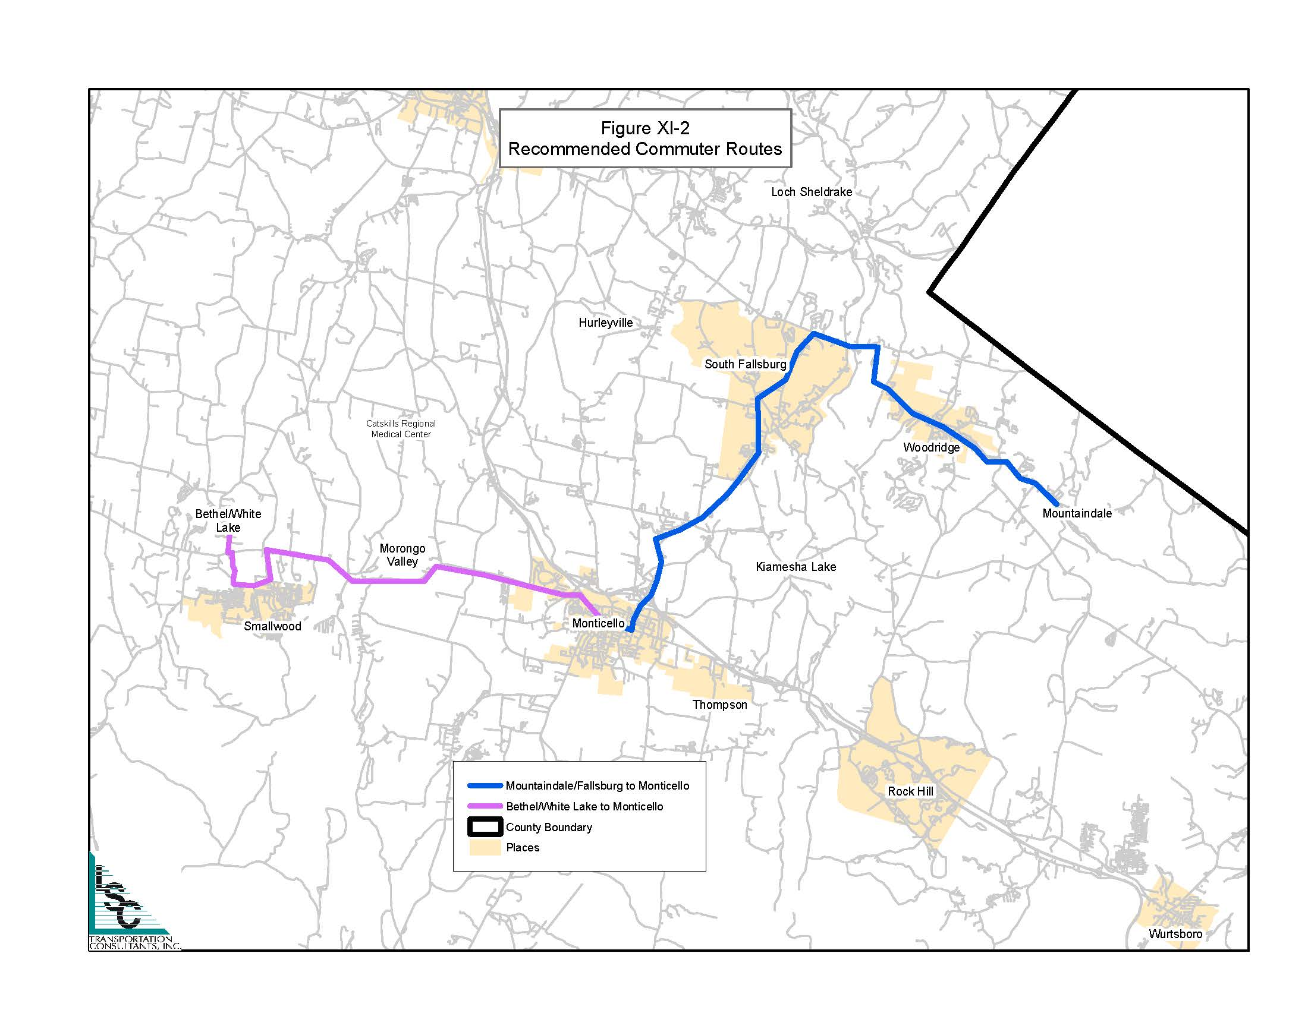

Slide 19
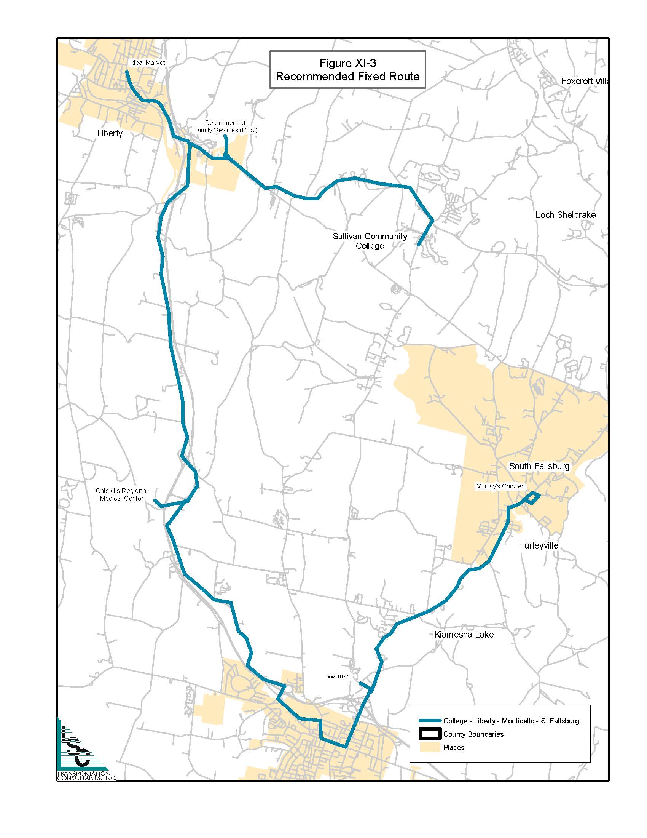

Slide 20
Phase 1: 2015-2017
Consolidate County Transportation Programs
County Transportation Manager/Coordinator
Coordinated (non-County) Human Services Transportation
Coordinating Council
Marketing Program

Slide 21
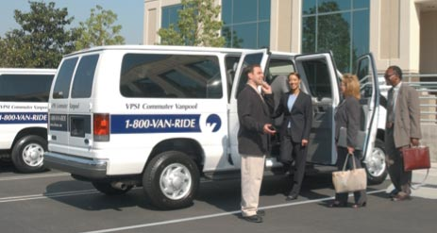
Phase 1 Services
Lifeline Service
Commuter Routes
Vanpool Program

Slide 22
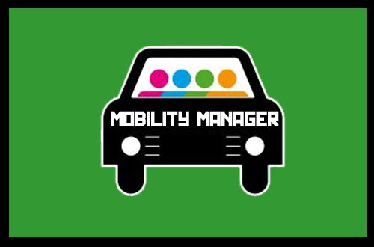
Phase 2: 2017-2019
Mobility Manager
Transportation Coalition

Slide 23
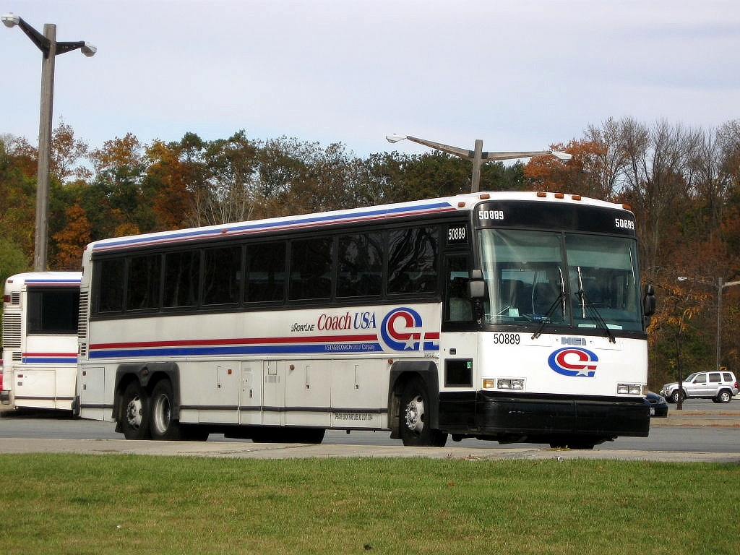
Phase 2 Services
Expand Vanpool Program
Fixed-Route Service

Slide 24
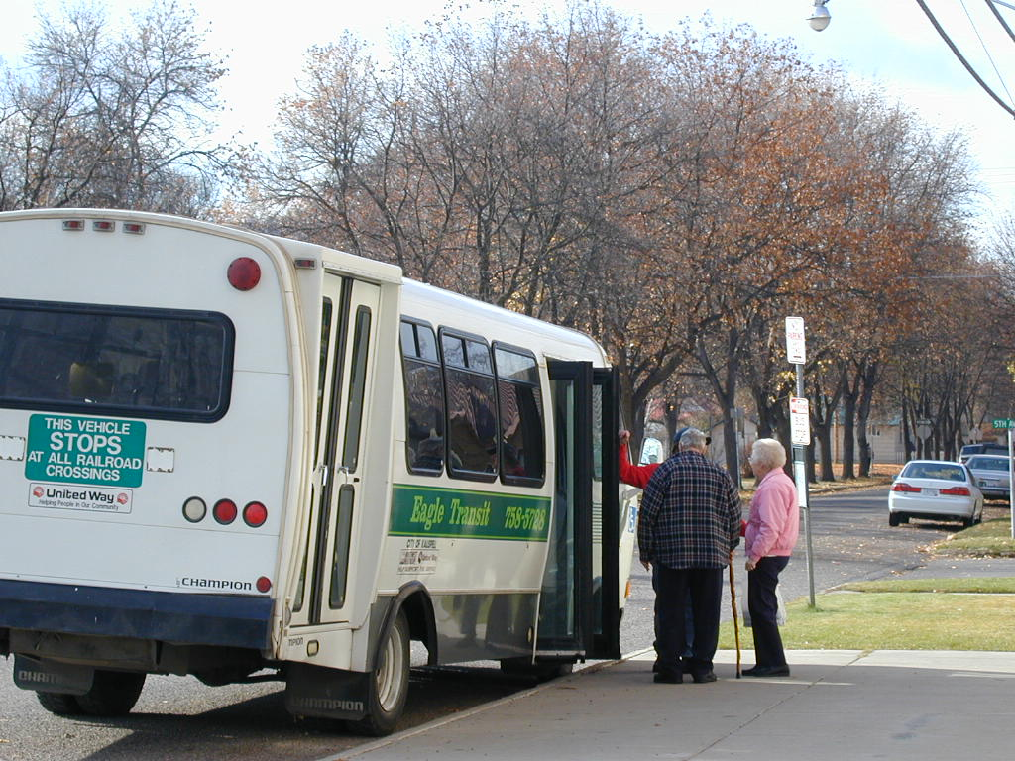
Phase 3: 2019-2022
Consolidate Human Services Transportation

Slide 25
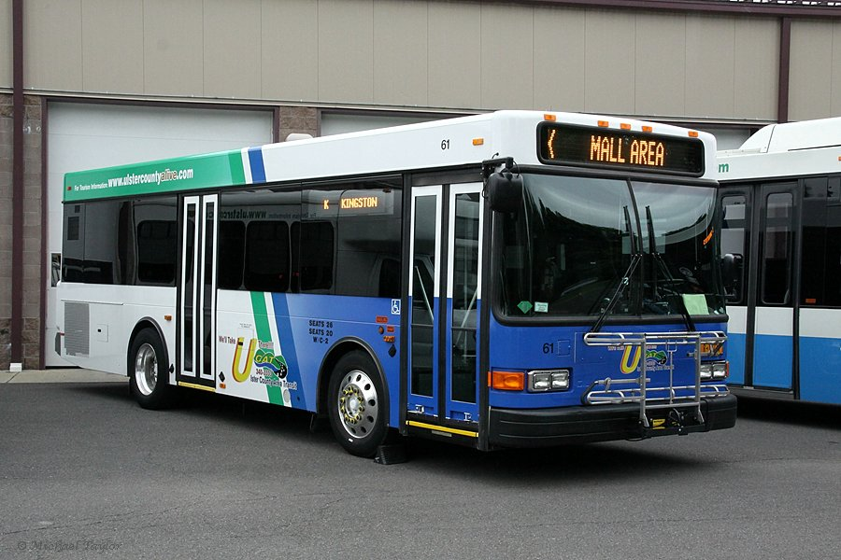
Phase 3 Services
Commuter Routes
Increase Fixed-Route Service
Regional Service

Slide 26
Summary
Significant Unmet Needs
Low Income
Potential Work Force
Significant Resources
Leveraging Resources
Increase service for non-program trips
Match Federal Transit Administration Funding
Improve Efficiency

