Slide 1
Public Safety Communications Upgrade Project
Division of Public Safety &
Blue Wing Services
September 11, 2012

Slide 2
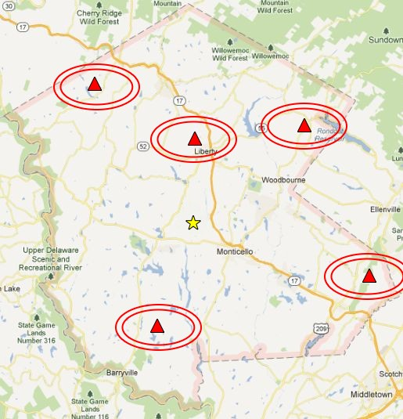
Current 911 Radio System
Services over 60 public safety agencies (Fire, EMS, Law Enforcement)
5 Towers located throughout the County
Single tower
simplex
transmissions
Primary
White Lake
Backup
SP Liberty

Slide 3
Current 911 Radio System
Majority of the infrastructure was constructed in the early 1980’s
Well maintained “in-house” by our DPW and radio tech John Conley
Towers are in fair condition to support existing equipment. Would not support industry standard equipment of today

Slide 4
Advantages of current system
Simple radio technology not many computer components
Luxury of having it maintained it for 30 years “in house”
Older equipment generally had a longer life cycle

Slide 5
Concerns of the current system
The backbone microwave equipment is 1970’s vintage of which replacement parts are even beyond eBay availability
The radio console equipment at the 911 Center was installed during 911 implementation in 2000
Parts availability
Tech retirement and ability to find vendor to support existing equipment
Coverage - gaps in coverage and growing environmental noise interference on low band (cable boxes, PC’s, wi-fi,etc.)
In building coverage poor on low band

Slide 6
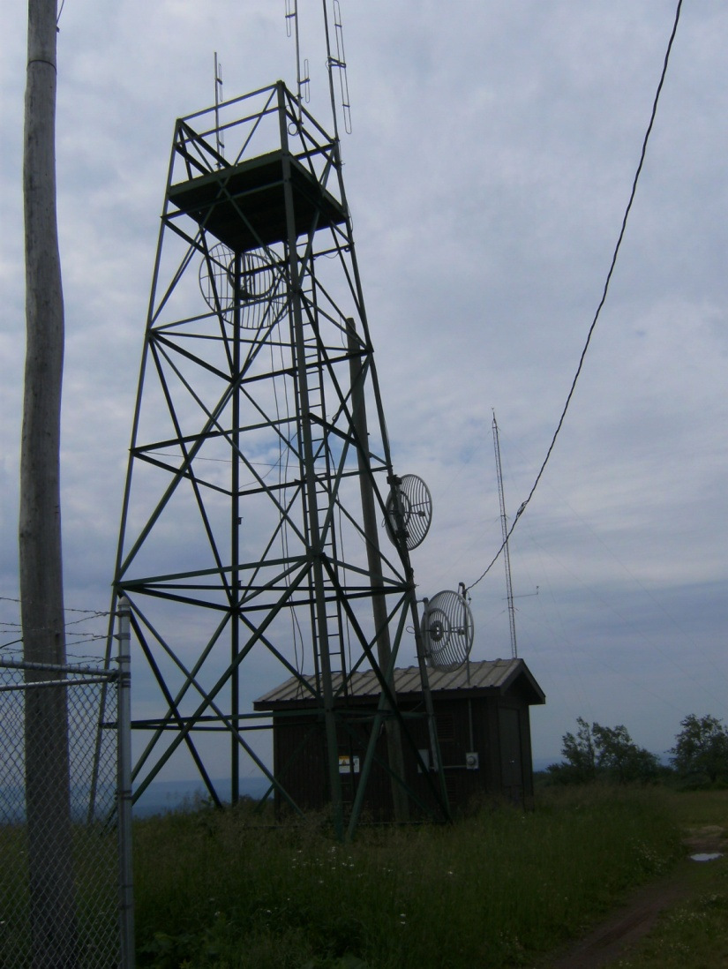
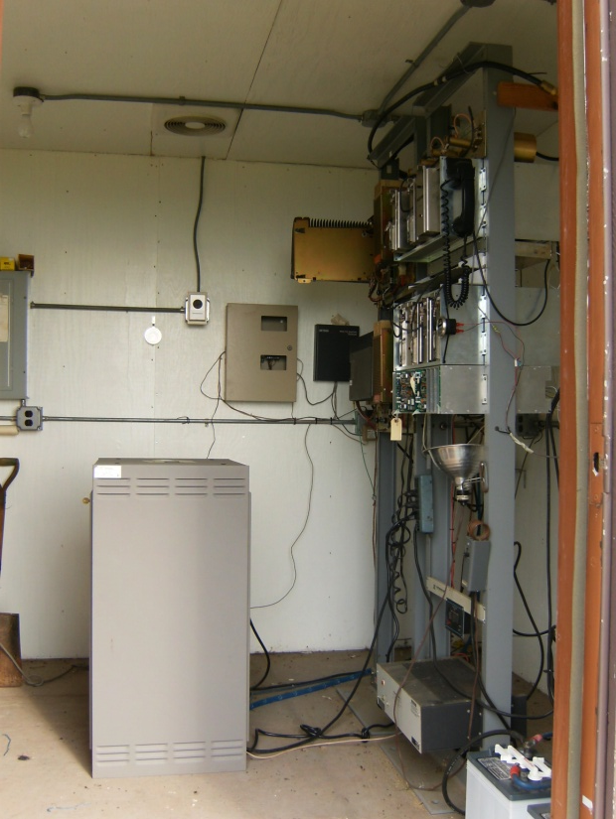
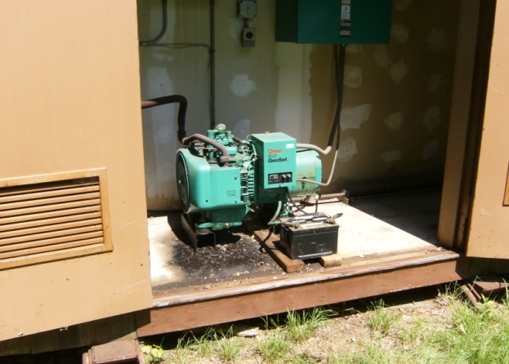
Current 911 Radio System

Slide 7
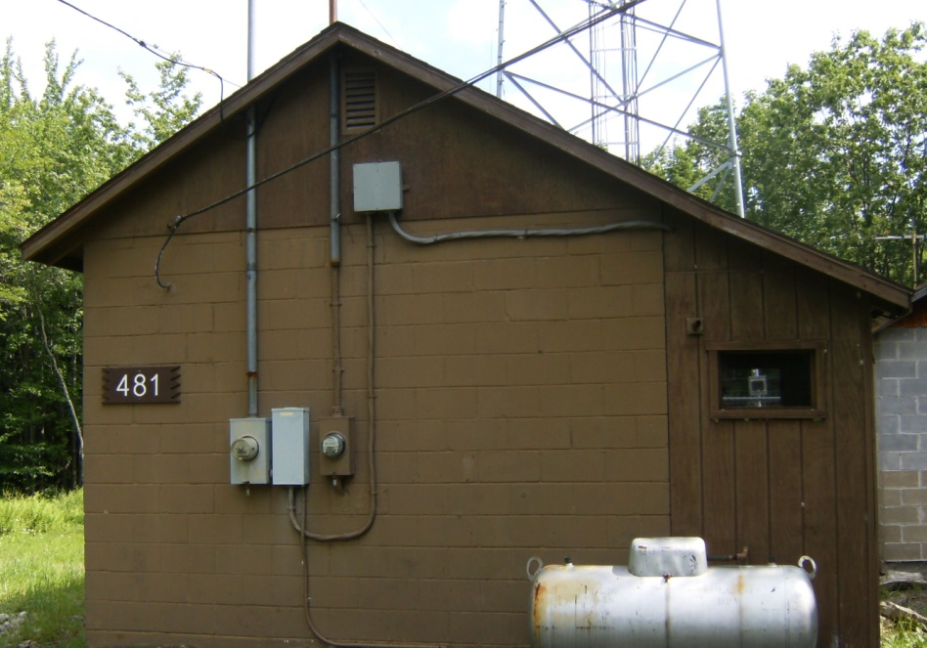
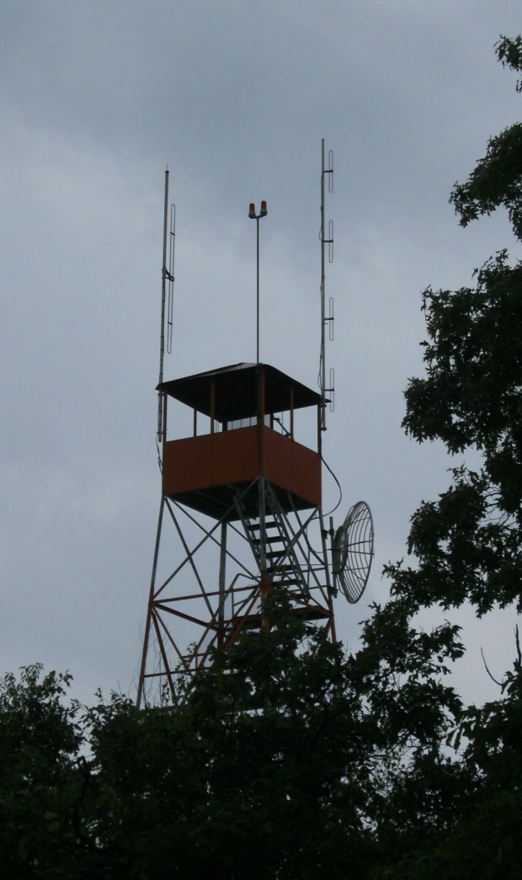
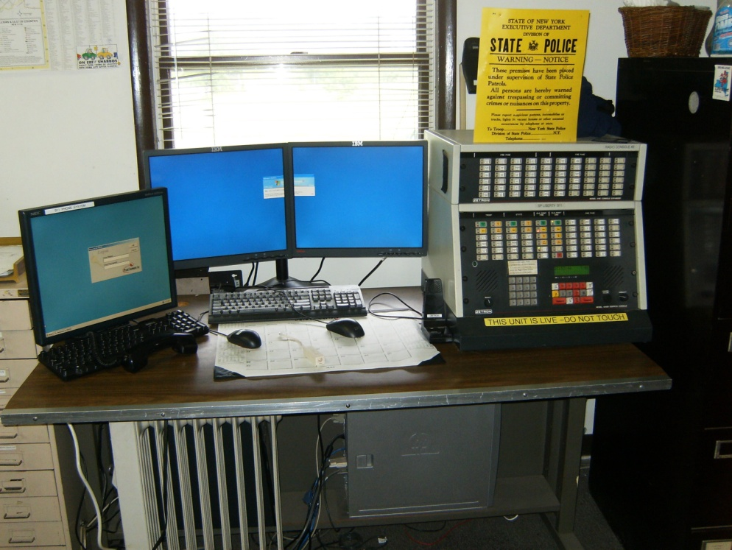
Current 911 Radio System

Slide 8
Other County Systems
Sheriff’s Office (VHF High Band)
County DPW (VHF Low Band)
Highway/Civil Defense (VHF High)
Fire Service (VHF Low Band)
EMS Service (VHF High Band)
Local Police (VHF High Band)

Slide 9
Route to upgrade…
In 2002 NYS announced a $2 Billion project to develop a statewide wireless network.
  It was going to support not only state but local communications as well
  Sullivan County was on board
  In 2004 they awarded the contract to MA/COM
  In 2009 they terminated contract with MA/COM

Slide 10
Route to upgrade…
Many counties were counting on this statewide system only to be disappointed
NYS then turned their focus to promoting the “network-of-networks” theory – Consortiums
2009 we contracted with Blue Wing Services to provide needs assessment , evaluate pros/cons, and make recommendations to improve our radio system(s)

Slide 11
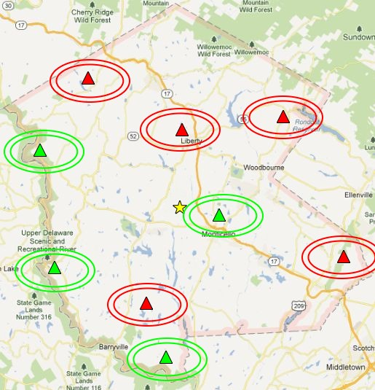
Blue Wing
Recommendations/Goals
Operations focus – provide a pragmatic cost effective solution
Improve coverage
  More tower sites
  Utilize VHF High Band (Cease Low Band)
Simulcast
Common
freq band
for interop
Upgrade
Infrastructure
& Equipment

Slide 12
Blue Wing
Alternatives
Presented (3) upgrade alternatives
  Rebuild of existing system ($5.6M)
    a. Same split systems as today (no interop)
    No additional towers to improve coverage
    New base station radios at towers
  2. Analog conventional system ($9.7M)
    a. Common frequency band for all responders
    b. Refresh and add to existing infrastructure to fill coverage voids
    c. Utilize some common features (UID, Simulcast)
  Digital Trunked system ($19.2M)
County leaders and emergency services representatives vetted the options to select a system that would be best suited/cost effective for the County.

Slide 13
Highlights of the upgrade
Consolidates 911/Fire/EMS/SCSO/DPW into a common radio system with shared infrastructure (Towers, buildings, generators, microwave,etc.)
Towers and infrastructure capable of supporting today's radio equipment and allow for co-location of wireless providers (Revenue and improved cellular coverage)
Many more redundancies built in for disaster recovery and much greater coverage from our backup 911 location
Improved coverage; Less “dead spots”
Much greater interoperability among disciplines being on common VHF High band frequencies – all field personnel will have like mobile radios

Slide 14
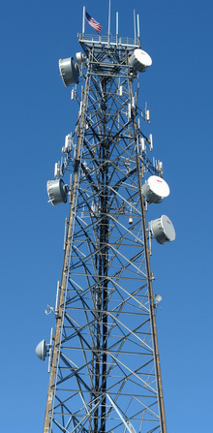

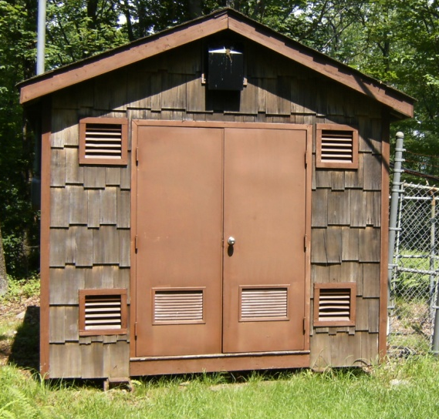
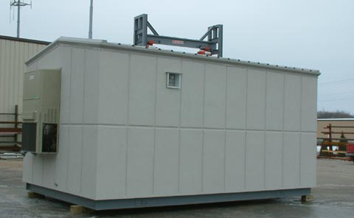
Before & After…

Slide 15
Outside
Systems
County DPW
Highway
Dept
SYSTEM
UPGRADE
EMS Service
SCSO
Fire Service

Slide 16
First steps…
Legislature approved PS upgrade project in the 2012-2017 capital plan
Many counties looking for frequencies – Motorola identified as having available VHF High Band frequencies
Negotiated & executed a $4.2M agreement with Motorola for frequencies and radio equipment (Dec 2010)
Began detailed process of tower location identification, SEQRA,
NEPA, FCC/FAA approvals

Slide 17
Where are we today…
Motorola filed application(s) to FCC for transfer of VHF High Band frequencies to Sullivan County
As of August 2012 – FCC granted application for transfer
(However not a “final order” yet)
SEQRA complete, only awaiting final tribal review now – 30 days
Tower development

Slide 18
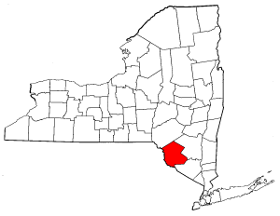
Our NY Neighbors
Proposed or in progress
Broome County $35 million
Ulster County $19 million
Otsego County $15 million
Purchased in the last 6-7 years
Madison County $14 million
Nassau County $42 million
Onondaga County $32 million
Oswego County $20 million
Rockland County $20 million
Saratoga County $17 million
Tompkins County $14 million

Slide 19
Timeline – Till now
2009
  Retained Blue Wing for needs assessment study
2010
  Study complete
  Met with Emerg Srvc community and vetted operational needs against the study finding
  Identified available VHF spectrum
  Negotiated and signed agreement with Motorola
2011
  Application submitted to FCC for transfer of freq
  Tower site development process began
  Civil work began – Chazen Companies retained (SEQRA / NEPA / FCC / FAA approvals)
2012
  Continued site development and frequency process
  FCC granted frequency transfer (Aug 2012)

Slide 20
Timeline – Moving Forward
2012
  Reaffirm priority in capital plan
  Complete land acquisition process
  Finalize site specific design plans
2013
  Focus on completing site/infrastructure build out
    Towers, buildings and microwave connections
  Power and generator installation
2014
  Complete microwave system installation
  Install radio system
  Testing of system
  Cutover to new system

Slide 21
Projected Overall Budget
Sites
Buildings | $1,000,000
Towers | $1,050,000
Civil/Regulatory (SEQRA, permits, land clearing) | $750,000
Microwave Interconnects (6 GHz) | $1,500,000
Total Site Cost | $4,300,000
Radio System
Upgrade legacy conventional base stations | $960,000
Motorola Radio System/Frequency Cost | $4,260,960
Radio consoles equipment | $341,000
Battery system | $582,000
Total Radio System Cost | $6,143,960
Total County End User Equipment (DPW) | 72,000
Total Capital Expenditure | $10,515,960
Grants & Other revenues to date | -1,380,000
Total projected capital cost | $ 9,123,960
* Annual maintenance & operations cost | $300 - $350K

Slide 22
Costs to date:
Chazen companies (SEQRA / FCC / FAA) | $31,000
Motorola – FCC Application | $50,000
Blue Wing Services (Many outside services incl) | $233,686
Total: | $314,686

Slide 23
Tentative budget timeline:
 | By Quarter | Total
2013 |  | $3,261,644
Quarter 1 | $ 0
Quarter 2 | $ 575,000
Quarter 3 | $ 1,525,000
Quarter 4 | $ 1,161,644
2014 |  | $ 4,809,576
Quarter 1 | $ 2,223,836
Quarter 2 | $ 0
Quarter 3 | $ 960,000
Quarter 4 | $ 1,625,740
2015 |  | $1,052,740
Quarter 1 | $ 1,052,740
Quarter 2 | $ 0
Quarter 3 | $ 0
Quarter 4 | $ 0
TOTAL |  | $9,123,960

Slide 24
Funding Sources
Successfully awarded $1.2M in grants ($900K offset)
Receive an estimated $300,000 annually in direct county 911 surcharge from landline/wireless/VOIP
Approximately $250,000 awarded in SHSP
Receive $38,000 annually from NYS for 911 reimbursement
  We must continue campaign to get NYS to stop raiding the 911 surcharge money ($190M collected statewide in 2011)
Continue to apply for these State Interop Grants as NYS makes the funding available (Pending $800,000 application right now)
Co-Location income & partnerships with other government agencies (Delaware, NPS , NYSP)

